Slide 1
Radioactivity and particles

Slide 2
Radioactivity and particles
Isotopes: atoms of the same element with a different number of neutrons

Slide 3
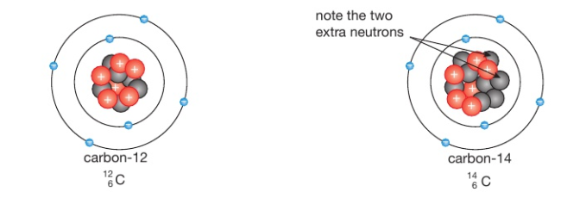
Radioactivity and particles
Isotopes: atoms of the same element with a different number of neutrons

Slide 4
Radioactivity and particles
Exercise: Fill-in the missing for each of the following:
${}_{Z}^{16}O {}_{6}^{12}X$ ${}_{3}^{A}{Li}$ ${}_{Z}^{20}{Ne}$ ${}_{20}^{40}X$ ${}_{}^{207}{Pb}$

Slide 5
Radioactivity and particles
Exercise: classify each of the following as stable or radioactive ?
${}_{9}^{19}F {}_{6}^{12}C$ ${}_{6}^{14}C$ ${}_{53}^{127}I$ ${}_{53}^{131}I$ ${}_{82}^{207}{Pb}$

Slide 6
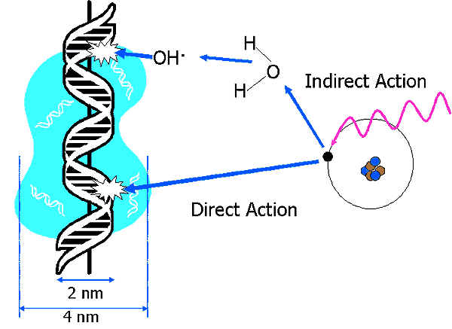
Radioactivity and particles
Ionizing radiation: causes a gain or loss of electric charge in materials

Slide 7
Types of ionizing radiation
Radioactivity and particles
Radioactivity is a random process..
Some atoms emit αlpha particles when decaying,
Some atoms emit βeta particles when decaying
Some atoms emit γ (gamma) energy when decaying

Slide 8
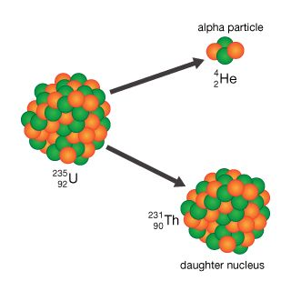
α decay
Radioactivity and particles
Example of elements undergoing α decay:
The atom loses 4 mass numbers and 2 atomic number So, α decay during A-4 , Z-2
Usually, very heavy atoms give alpha particles to become lighter

Slide 9
α decay
Radioactivity and particles
Because they are highly ionizing, αlpha particles have a limited range of a few 2-8 cm in air.
So, alpha particles easily collide and interact with atoms and are stopped more easily.
Alpha particles are helium ions (positively charged +2)
Alpha particles can be stopped by a sheet of paper
alpha decay : A-4 , Z-2

Slide 10
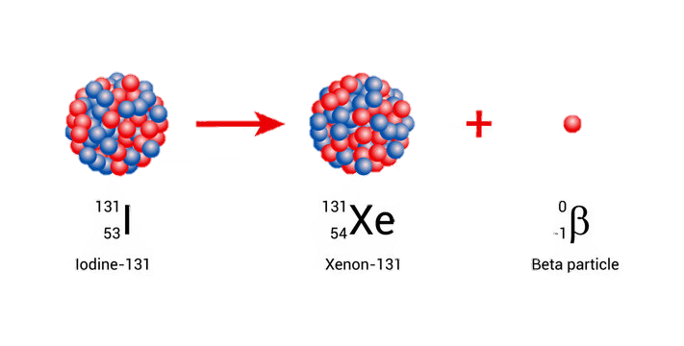
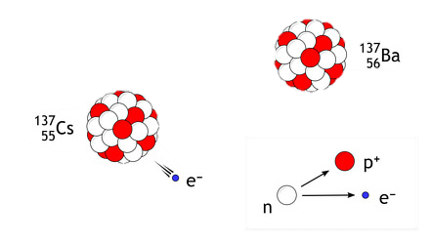
β decay
Radioactivity and particles
Is the emission of an electron from the decay in the nucleus.
The β particle (an electron)
Electrons are much lighter and smaller than α particles
Electrons have a charge of -1 , so they have a longer range
Most βeta particles can be stopped by aluminum foil Beta decay converts a neutron to a proton
Z + 1
Electrons are 2000 times lighter than protons
Notes:
1/2000th the mass of a proton or neutron

Slide 11
γ decay
Radioactivity and particles
γ decay involves the emission of γ-rays (energy not a particle) in the form of very high energy photons.
γ-rays are uncharged
γ-rays are not particles, so they seldom interact with atoms
So, γ-rays have a very long range

Slide 12
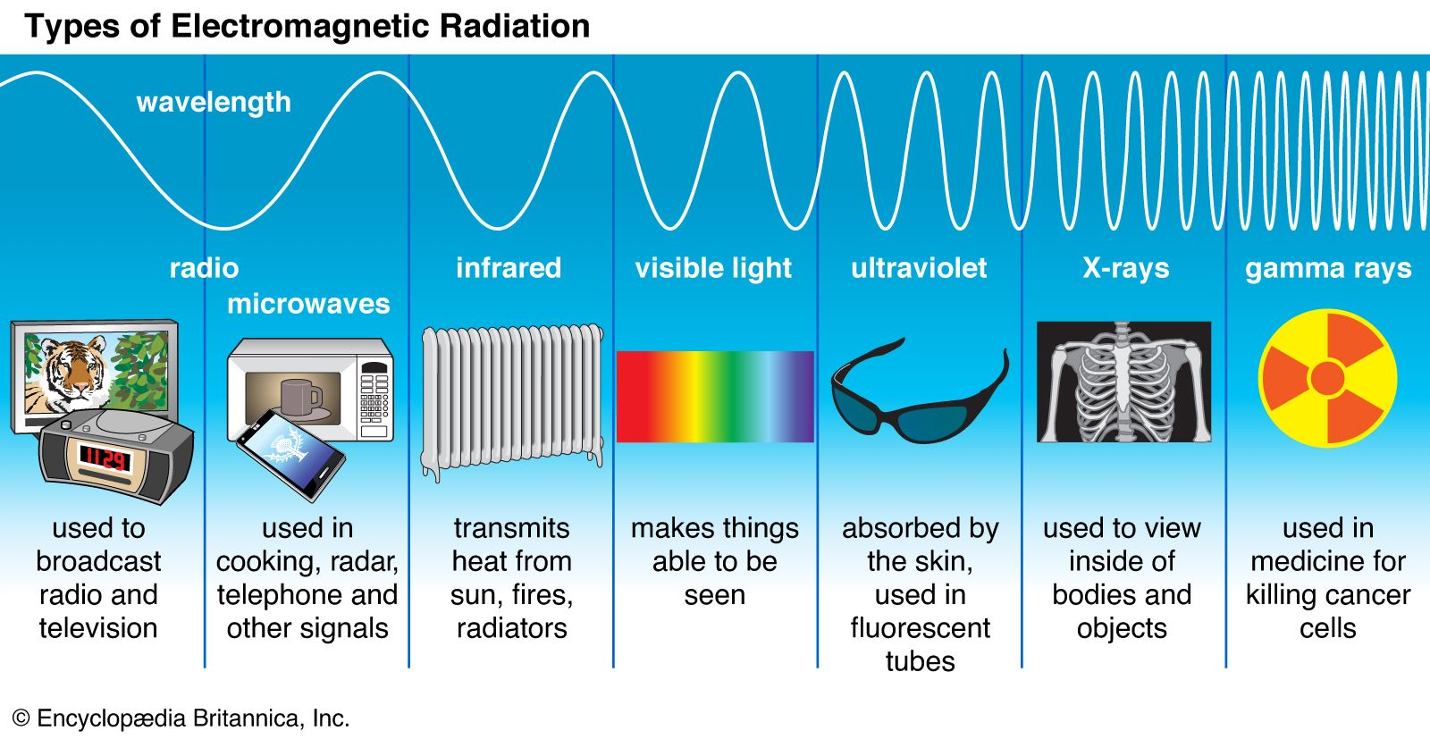
γ decay
Radioactivity and particles
γ decay involves the emission of γ-rays (energy not a particle) in the form of very high energy photons.
γ-rays are uncharged
γ-rays are not particles, so they seldom interact with atoms
So, γ-rays have a very long range

Slide 13
Radioactivity and particles
Name of decay | Emitted particle | Range in air | Ionizing potential | Stopped by
α decay | Helium ⁺² | Low (2- 8 cm) | High | A sheet of paper
β decay | Electron ⁻¹ | Medium (50cm–1m) | Medium | Aluminum foil
γ decay | Gamma energy | High (several meters) | Weak | Thick lead sheet

Slide 14
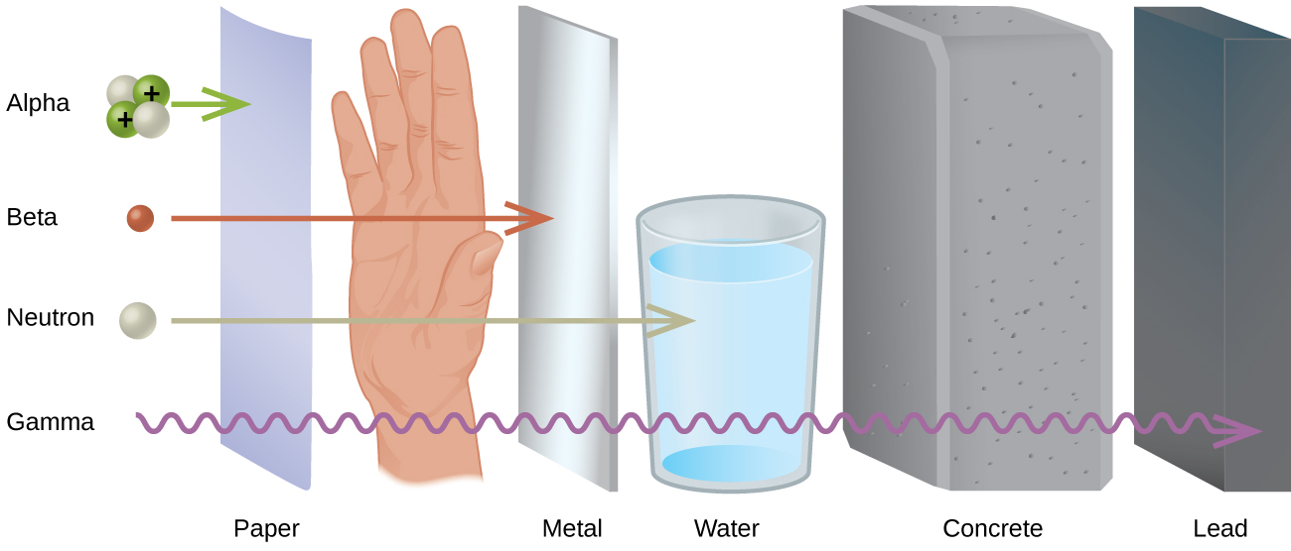
Radioactivity and particles

Slide 15
Radioactivity and particles
Because they are highly ionizing, αlpha particles have a limited range of a few 2-8 cm in air.
So, alpha particles easily collide and interact with atoms and are stopped more easily.
Alpha particles are helium ions (positively charged +2)
Alpha particles can be stopped by a sheet of paper

Slide 16
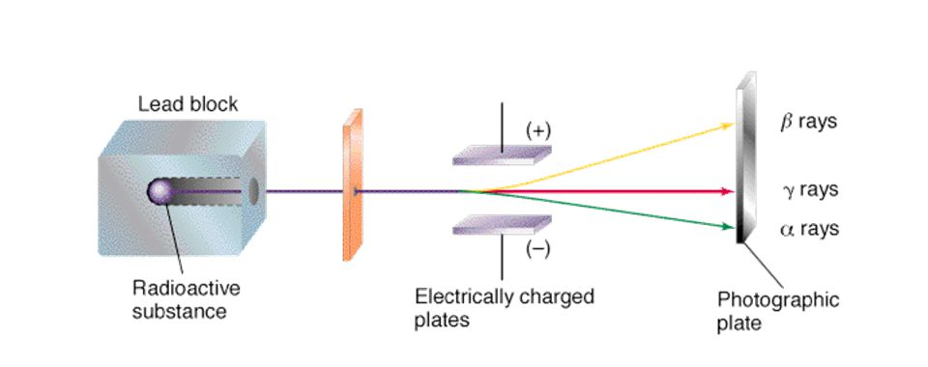
Radioactivity and particles

Slide 17
Radioactivity and particles

Slide 18
Radioactivity and particles

Slide 19
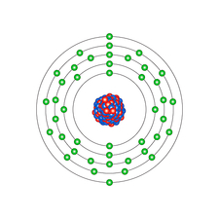
Radiation and Half-life
Radioactive elements tend to decay over time, the decay is a random process independent of chemical compounds or temperature.
Some elements decay more quickly than others, other elements take longer to decay
example
Half-life: 12.3 years
Half-life: 6 hours

Slide 20
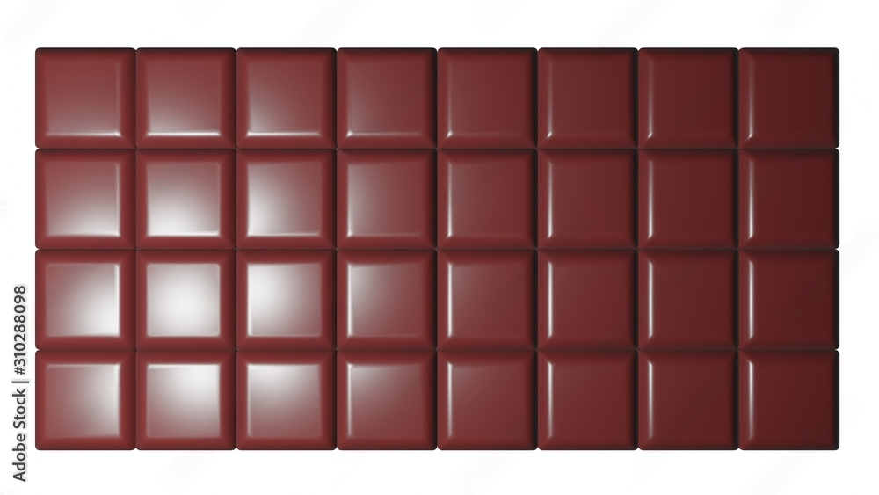
Radiation and Half-life
Half-life is the amount of time it takes for half of a sample of a radioactive substance to decay.
Chocolate bar example half life: 3 hours

Slide 21
Radiation and Half-life
Half-life is the amount of time it takes for half of a sample of a radioactive substance to decay.
Chocolate bar example half life: 3 hours

Slide 22
Radiation and Half-life
Half-life is the amount of time it takes for half of a sample of a radioactive substance to decay.
Chocolate bar example half life: 3 hours

Slide 23
Radiation and Half-life
Half-life is the amount of time it takes for half of a sample of a radioactive substance to decay.
Chocolate bar example half life: 3 hours

Slide 24
Radiation and Half-life
Half-life is the amount of time it takes for half of a sample of a radioactive substance to decay.
Chocolate bar example half life: 3 hours

Slide 25
Applications of radioactivity
Radioactive elements tend to decay over time, the decay is a random process independent of chemical compounds or temperature, but depends on the isotope (element) itself
Some elements decay more quickly than others, other elements take longer to decay
Technicium-99
Half-life: 12.3 years
Half-life: 6 hours

Slide 26
Practical applications of radioactivity
Applications of radioactivity
Radioactive tracers in medical diagnosis (radiology)
Treatment of cancer (radiotherapy)
Sterilization using γ-rays
γ-ray imaging (radiography)
Measuring the flow of liquids and gases

Slide 27
Practical applications of radioactivity
Applications of radioactivity
Radioactive tracers in medical diagnosis (radiology)

Slide 28
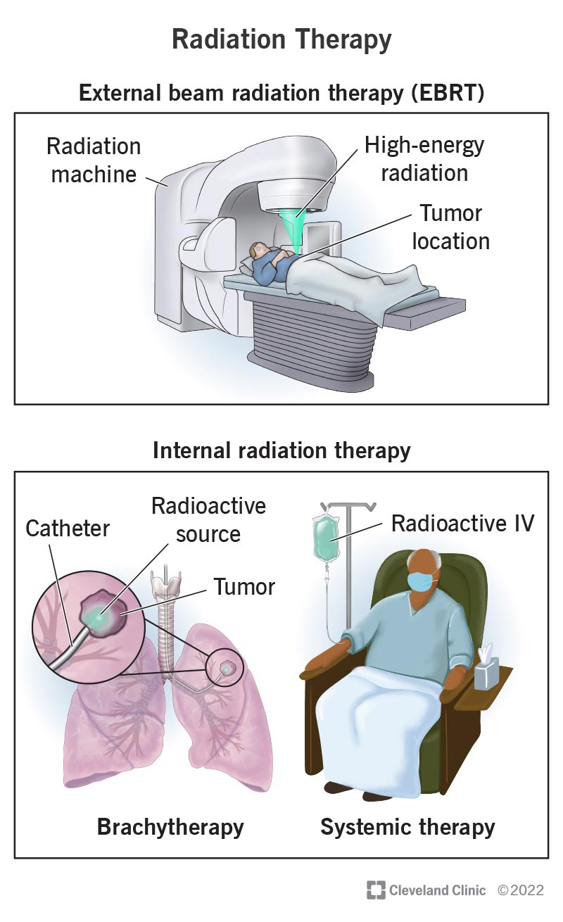
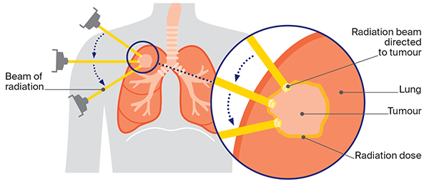
Practical applications of radioactivity
Applications of radioactivity
Treatment of cancer (radiotherapy): This can be done externally by irradiating using gamma rays, or internally by inserting the radioisotope in the body

Slide 29
Practical applications of radioactivity
Applications of radioactivity
Remove or kill bacteria or other living microorganisms.
Sterilization using y-rays :
https://www.youtube.com/watch?v=pe6AKh_tLys

Slide 30
Practical applications of radioactivity
Applications of radioactivity
Sterilization using y-rays :
https://www.youtube.com/watch?v=pe6AKh_tLys

Slide 31
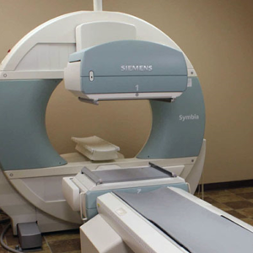
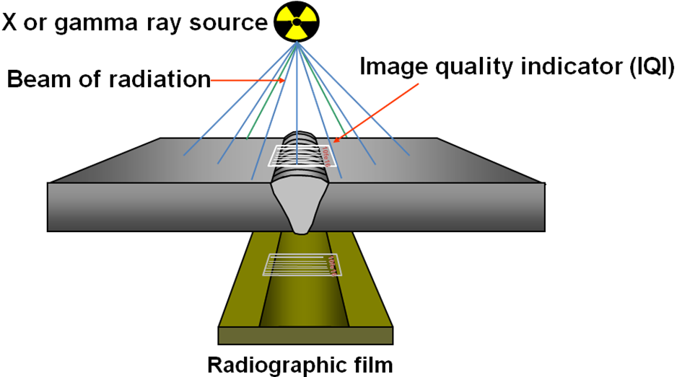
Practical applications of radioactivity
Applications of radioactivity
γ-ray imaging (radiography): allows us to see inside the human body, or test materials if they are broken.

Slide 32
Practical applications of radioactivity
Applications of radioactivity
Measuring flow of liquids and gases: by inserting some gamma emitter, we can find the location of the leak in pipes

Slide 33
Practical applications of radioactivity
Applications of radioactivity
Measuring flow of liquids and gases: by inserting some gamma emitter, we can find the location of the leak in pipes

Slide 34
Practical applications of radioactivity
Applications of radioactivity
Radioactive dating: Knowing the half life, and amount of radiation, we can estimate the age of organic matter for example

Slide 35
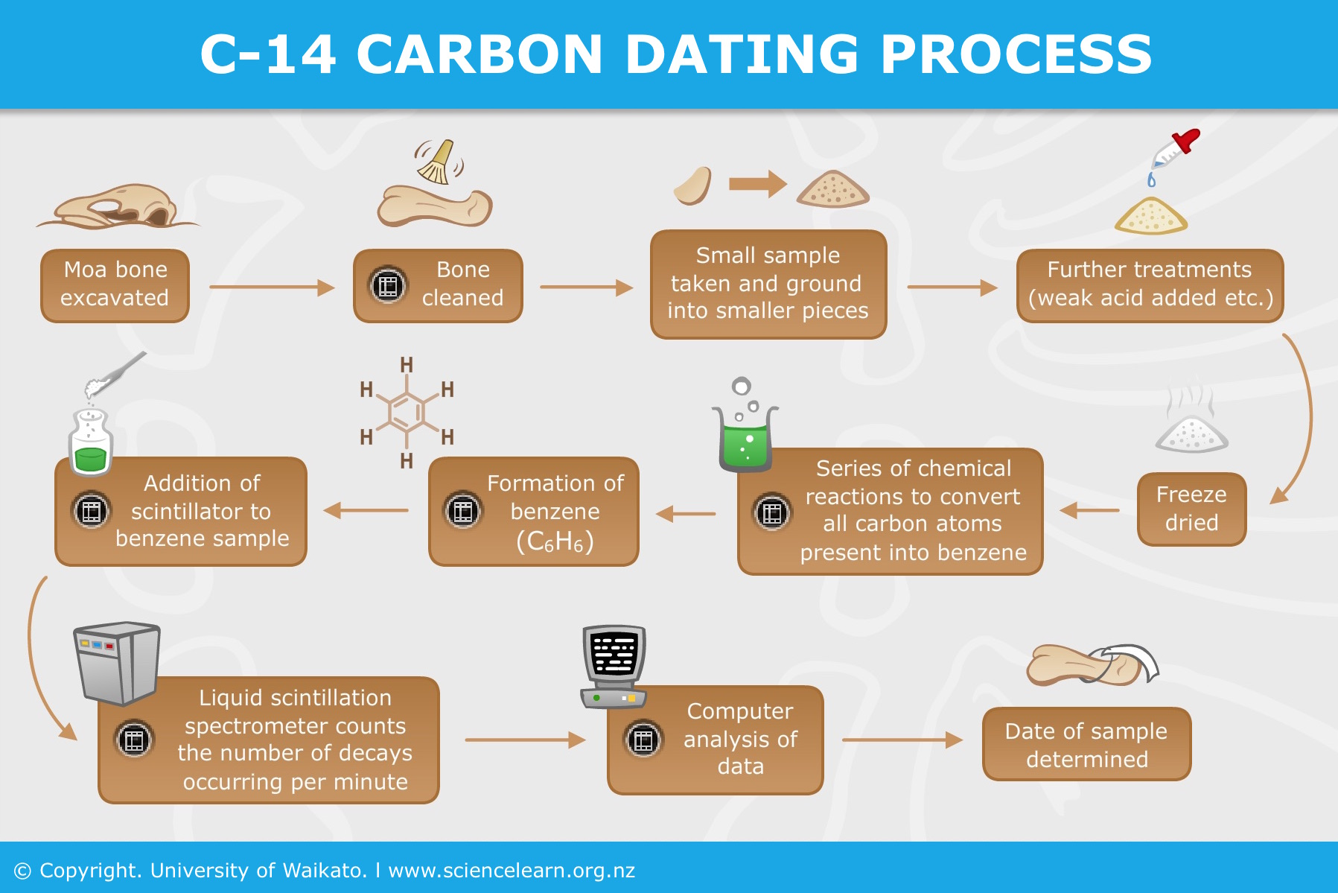
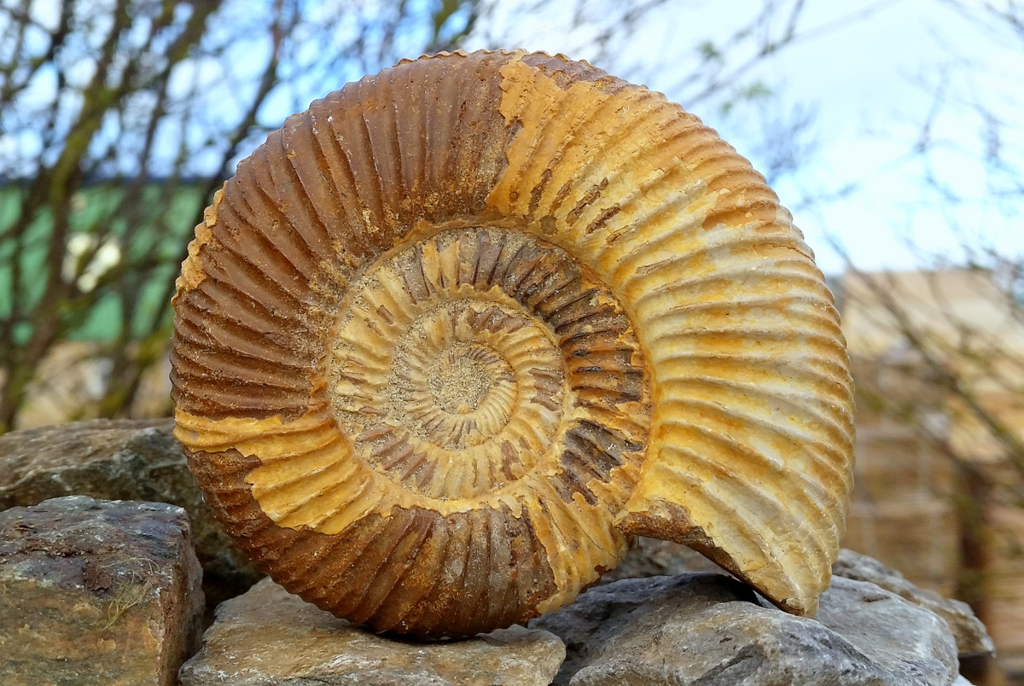
Practical applications of radioactivity
Applications of radioactivity
Radioactive dating: Knowing the half life, and amount of radiation, we can estimate the age of organic matter for example

Slide 36
Practical applications of radioactivity
Applications of radioactivity
Radioactive dating: Knowing the half life, and amount of radiation, we can estimate the age of organic matter, for example fossils

Slide 37
Practical applications of radioactivity
Applications of radioactivity

